Slide 1
Google Map API
Session - 2

Slide 2
Session -2
Static Map API

Slide 3
Static Map API
The Google Static Maps API returns an image (either GIF, PNG or JPEG) in response to an HTTP request via a URL. For each request, you can specify the location of the map, the size of the image, the zoom level, the type of map, and the placement of optional markers at locations on the map. You can additionally label your markers using alphanumeric characters.
https://developers.google.com/maps/documentation/static-maps

Slide 4
URL Parameters
A Google Static Maps API URL must be of the following form:
https://maps.googleapis.com/maps/api/staticmap?parameters
Details of the parametrers
https://developers.google.com/maps/documentation/static-maps/intro

Slide 5
Location Parameters

Slide 6
Map Parameters

Slide 7
Feature Parameters

Slide 8
Key and Signature Parameters

Slide 9
URL Size Restriction

Slide 10
Specifying Locations
The Google Static Maps API must be able to precisely identify locations on the map, both to focus the map at the correct location (using the center parameter) and/or to place any optional placemarks (using the markers parameter) at locations on the map.
The Google Static Maps API uses numbers (latitude and longitude values) or strings (addresses) to specify these locations. These values identify a geocoded location.
Several parameters (such as the markers and path parameters) take multiple locations. In those cases, the locations are separated by the pipe (|) character.

Slide 11
Zoom Levels
1: World
5: Landmass/continent
10: City
15: Streets
20: Buildings

Slide 12
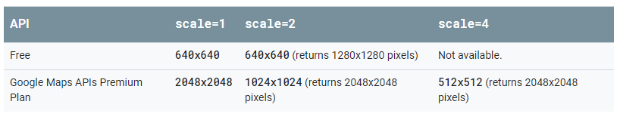
Image Sizes

Slide 13
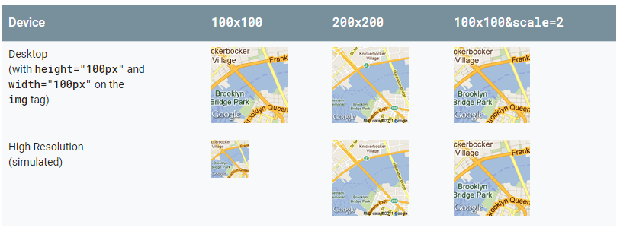
Scale Values

Slide 14
Image Formats
png8 or png (default) specifies the 8-bit PNG format.
png32 specifies the 32-bit PNG format.
gif specifies the GIF format.
jpg specifies the JPEG compression format.
jpg-baseline specifies a non-progressive JPEG compression format.

Slide 15
Map Types
roadmap (default) specifies a standard roadmap image, as is normally shown on the Google Maps website. If no maptype value is specified, the Google Static Maps API serves roadmap tiles by default.
satellite specifies a satellite image.
terrain specifies a physical relief map image, showing terrain and vegetation.
hybrid specifies a hybrid of the satellite and roadmap image, showing a transparent layer of major streets and place names on the satellite image.

Slide 16
Styled Map
Customize the presentation of the standard Google map
You can change the visual display of features such as roads, parks, built-up areas, and other points of interest.
Change their color or style to emphasize particular content, complement surrounding content on the page, or even hide features completely.
https://developers.google.com/maps/documentation/static-maps/styling

Slide 17
Markers
markers=markerStyles|markerLocation1| markerLocation2|...

Slide 18
Marker Style
size: (optional) specifies the size of marker from the set {tiny, mid, small}. If no size parameter is set, the marker will appear in its default (normal) size.
color: (optional) specifies a 24-bit color (example: color=0xFFFFCC) or a predefined color from the set {black, brown, green, purple, yellow, blue, gray, orange, red, white}.
label: (optional) specifies a single uppercase alphanumeric character from the set {A-Z, 0-9}. (The requirement for uppercase characters is new to this version of the API.) Note that default and mid sized markers are the only markers capable of displaying an alphanumeric-character parameter. tiny and small markers are not capable of displaying an alphanumeric-character.

Slide 19
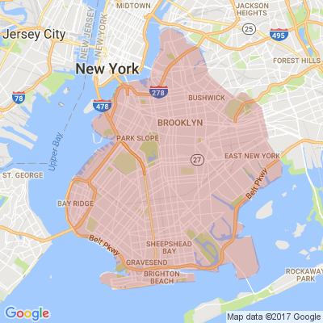
Paths

Slide 20
Pricing and Plans
https://enterprise.google.com/maps/pricing/

Slide 21
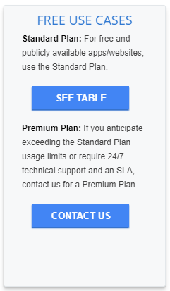
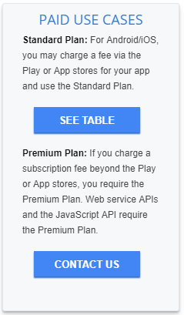
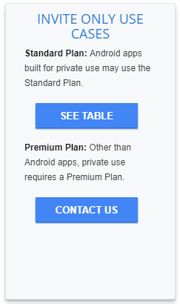
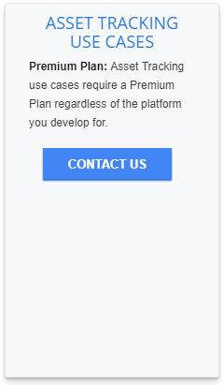
Pricing and Plans

